Slide 1
Moving Towards Real Engine Cycle

Slide 2
Air standard cycle vs. real cycle
Simple air standard cycles overestimate real engine cycle efficiency by a factor of about 2. For the real engine cycle:
• Air is not the working fluid (fuel and residual combustion gases are also present)
• Real gas effects are significant in real engine cycle (PV is not equal to mRT; Cv, Cp are not constants)
• Combustion occurs over a finite duration
• Non-isentropic compression and expansion processes (blow-by and blow-down)
• Heat transfer to cylinder walls is significant
• Gas exchange processes occurs in real engine
• Mechanical friction is significant in real engines

Slide 3
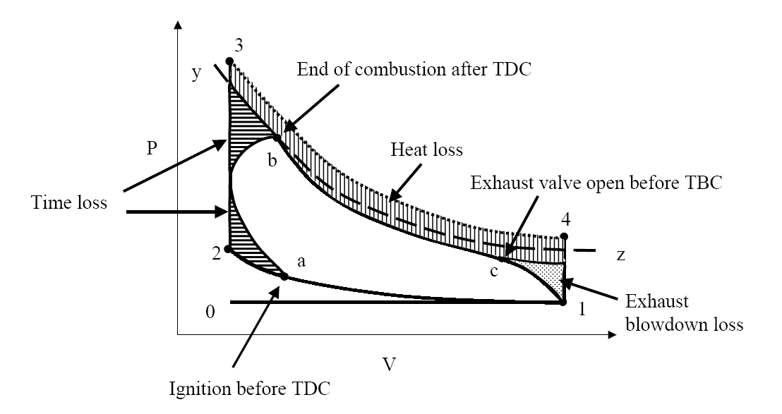
Air standard cycle vs. real cycle

Slide 4
Air standard cycle vs. real cycle
• Time loss: combustion is not an instantaneous process. It takes a finite time for the flame to propagate (time delay). It accounts for 30% of loss (as compared to an ideal cycle).
• Heat loss: heat is losing to walls and valve seats. 60% of loss.
• Exhaust blowdown loss: exhaust valve open (~47º) before TBC. This event associates with an immediate pressure drop and a loss of available work (10%)
• Other losses: pumping losses (important at partial throttle), poor mixing/unburned fuel loss, leakage losses (more severe for an older engine and at lower engine speed)

Slide 5
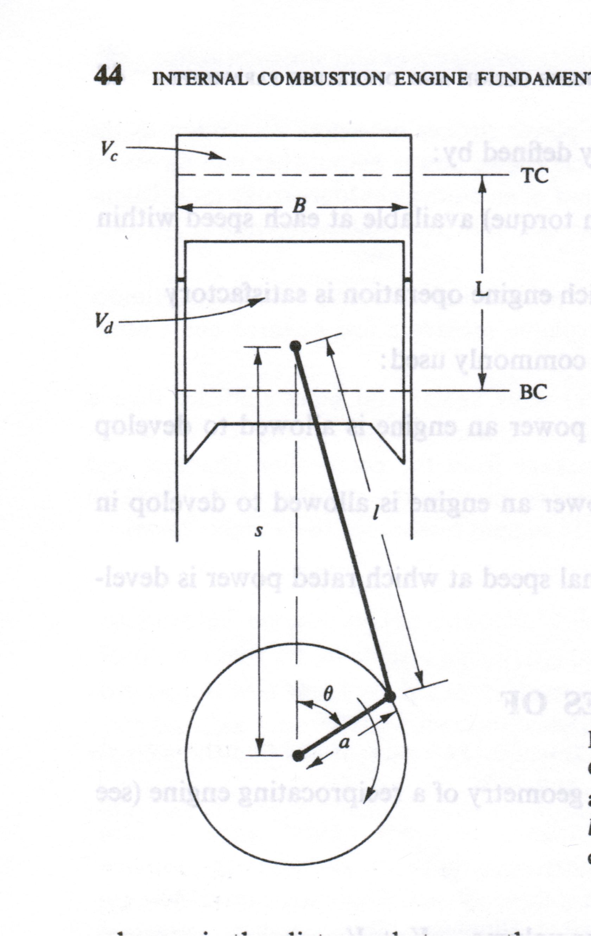
Engine Instantaneous Volume
Where,
R is the ratio of connecting rod length to crank radius
R = l/a

Slide 6
Finite Heat Release
Otto Cycle – Constant volume heat addition
Diesel Cycle – Constant pressure heat addition
Actual engine pressure and temperature profile do not match with these simple models
Finite heat release model: A differential model of an engine cycle in which the heat addition is specified as a function of the crank angle
Enables us to find the effects of spark timing or heat transfer on the engine work and efficiency

Slide 7
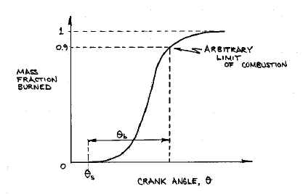
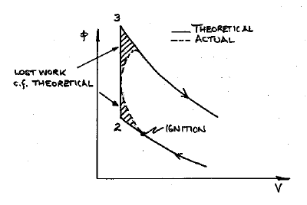
Typical Heat Release Curve
Typical cumulative heat release or ‘burn fraction’ curve for spark ignition engine is characterized by initial small slope beginning with spark ignition, followed by region of rapid growth, and then a more gradual decay

Slide 8
Further Closer to Real Cycle
Fuel Air Cycle
The simple air standard cycle overestimates the engine efficiency by a factor of about 2.
Reason - Assumption of constant specific heat
Heat capacities of gases are strongly dependent on temperature. So, the molar constant volume heat capacity will also vary, as will γ.
If this is allowed for, the air standard Otto cycle efficiency falls from 57 percent to 49.9 percent for a compression ratio of 8.
When allowance is made for the presence of fuel and combustion products there is even greater reduction in cycle efficiency – This leads to the concept of fuel-air cycle

Slide 9
Further Closer to Real Cycle
Fuel Air Cycle
The working substance in the real cycle is not only air but it is also a mixture of air, fuel, and residual gases left in the clearance space from previous cycle
Fuel-Air cycle is defined as the theoretical cycle that is based on the actual properties of the cylinder gases.

Slide 10
Further Closer to Real Cycle
Fuel Air Cycle differs from the idealized air standard cycle by
Including variable specific heats
Considering the composition of the fuel air mixture and exhaust products
Considering dissociation gases at high temperature.
The basic advantage of the fuel-air cycle analysis is that while the air cycle studies the effect of CR only on other parameters, with fuel-air cycle we can also study the effect of CR, F/A, inlet pressure and temperature, variable specific heat and other factors on engine performance.

Slide 11
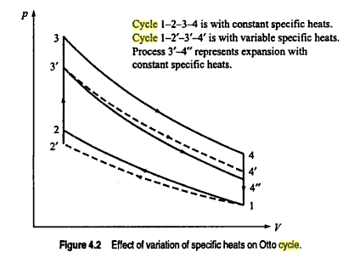
Further Closer to Real Cycle
All gases, except monoatomic gases, show an increase in specific heat capacities
The variation of specific heat capacity does not follow any law

Slide 12
Further Closer to Real Cycle
If the variation of specific heats is considered during the compression stroke, the values of temperature and pressure at the end of compression would be lower than that with fixed values
End of compression: 2’ instead of 2
With variable specific heats, the temperature T2’ at the end of compression can only be obtained by step-by-step calculations.
For this, the compression process is divided into a number of smaller steps and assuming constant specific heats for the smaller step. The temperature at end of each step are evaluated and finally T2’ is obtained
Process 2-3 combustion with constant sp heat
Process 2’-3’: combustion considering variable sp heat

Slide 13
Further Closer to Real Cycle
During the expansion process, the temperature decreases, therefore the sp heat also decrease. Due to this the temp of at the end of expansion stroke T4’ will be higher than T4” obtained without considering the variation
The Fuel Air Cycle analysis requires the use of tabulated or calculated thermodynamic property data for burned and unburned mixtures. These properties depend on
Fuel composition
Fuel air ratio
Water vapour content
Residual gas content

Slide 14
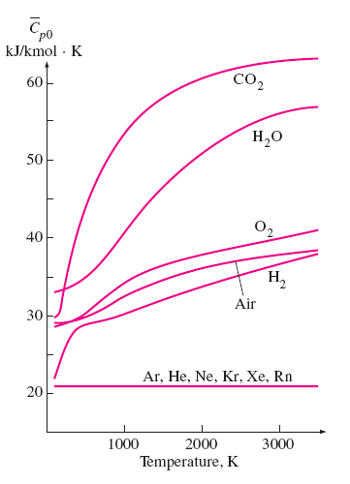
Variation of Specific Heat with Temperature

Slide 15
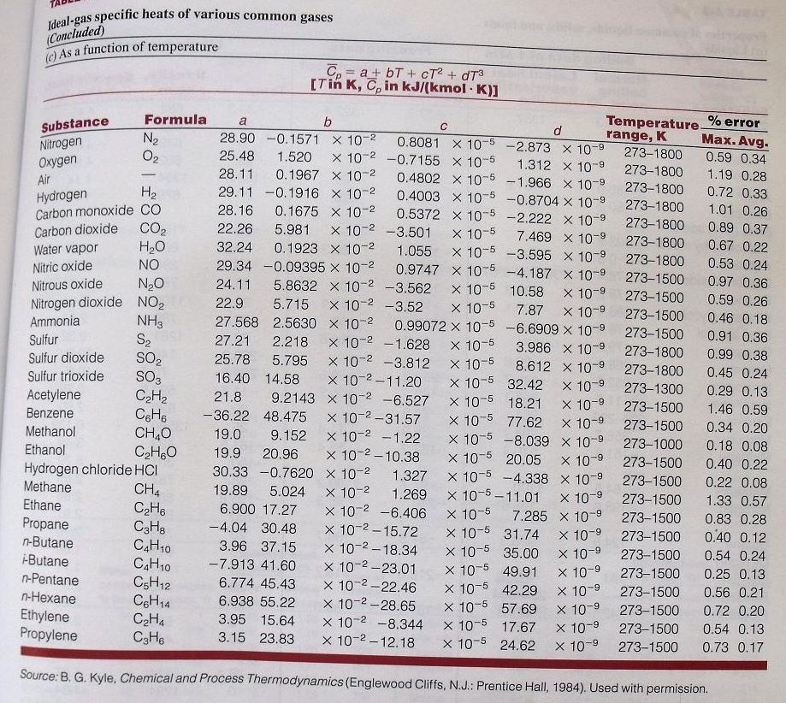

Slide 16
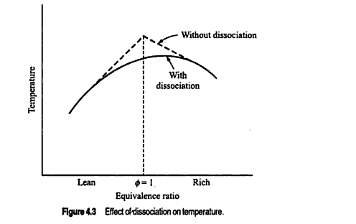
Further Closer to Real Cycle
The Effect of Dissociation
Dissociation is defined as the disintegration of burnt gases at high temperatures. Disintegration increases with temperatures.

Slide 17
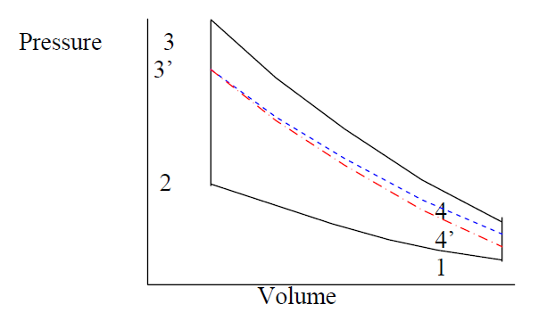
Further Closer to Real Cycle
The effects of dissociation
The general effect of dissociation can be explained as follows: as the temperature increases considerable amount of heat will be absorbed by the elements that undergoes dissociation. This heat will be liberated when these elements re-combine as the temperature falls.

Slide 18
Further Closer to Real Cycle
During the compression stroke : no significant change because the temperature is still below that required for the dissociation to commence.
During the combustion stroke : because of the high temperature rise during this process dissociation increases causing the maximum cylinder temperature and
pressure to drop. This is represented by the point 3’ instead of 3.
During the expansion stroke : the natural adiabatic expansion process would have been represented by the line 3-4’, but due to the re-association effect it will follow the path 3-4”. This is because the re-association process liberates some of this heat hence increases the end-of-expansion temperature and pressure though still below that of ideal cycle.

Slide 19
Further Closer to Real Cycle
Conclusion: Thus we see that the effect of dissociation is to lower the pressure and temperature at the beginning of the expansion stroke. This causes the engine to suffer a loss in power and drop in thermal efficiency and increase in specific fuel consumption.
Conclusion: Thus we see that the effect of dissociation is to lower the pressure and temperature at the beginning of the expansion stroke. This causes the engine to suffer a loss in power and drop in thermal efficiency and increase in specific fuel consumption.
Remedy: since the burning of nearly stoichiometric mixture will produce the maximum temperature, dissociation will be maximum at mixtures within
stoichiometric. As the mixture becomes lean or rich, the thermal energy produced due to combustion will be low and hence dissociation will be suppressed.

Slide 20
Further Closer to Real Cycle
The fuel air cycle analysis results in:
Efficiency increases with increasing compression ratio (as per air standard cycle
Leaning the mixture increases efficiency

Slide 21
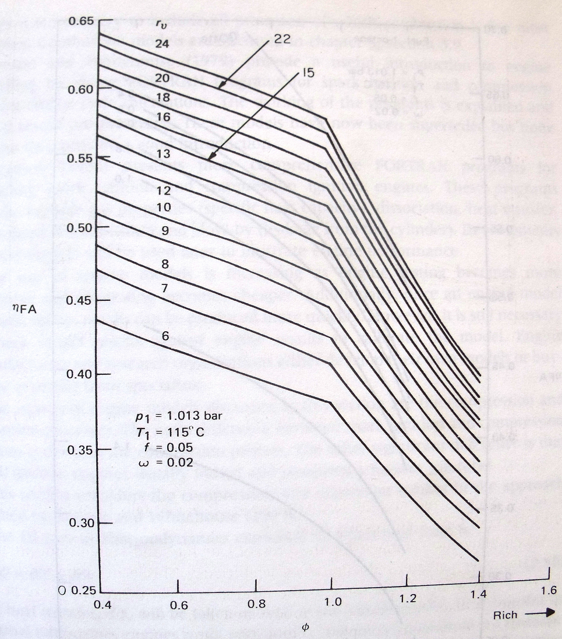
Results of Fuel Air Cycle

Slide 22
SUMMARY

Slide 23
Deviation of actual cycles from air standard cycles
Compression and expansion are not friction less adiabatic processes. A certain amount of friction is always present and there is considerable heat transfer between the gases and cylinder wall.
Combustion does not occur either at constant volume or at constant pressure.
The thermodynamics properties of the gases after combustion are different than those of the fuel-air mixture before combustion.
The combustion may be incomplete.
The specific heats of the working fluid are not constant but increases with temperature.

Slide 24
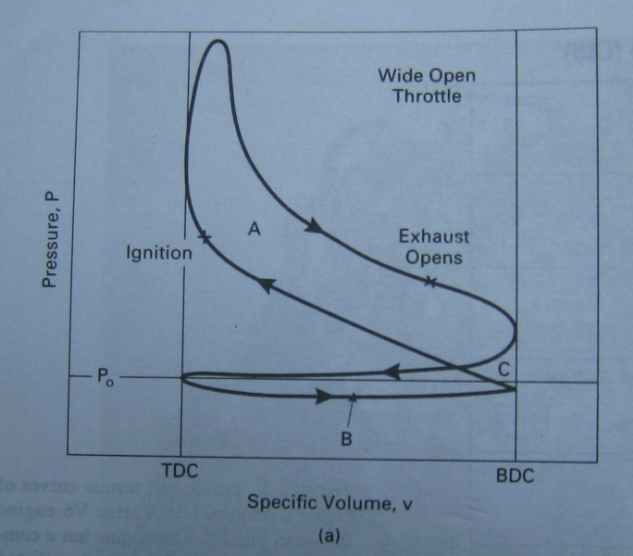
The cylinder pressure during exhaust process is higher than the atmosphere. As a result, more work has to be done by the piston on the gases to expel them out of the cylinder, than work done by the gases on the piston during the intake stroke. This difference in work, called pumping work, is represented by the pumping loop shown by hatched are. Note that this work is negative and represents loss of work called pumping loss.

Slide 25
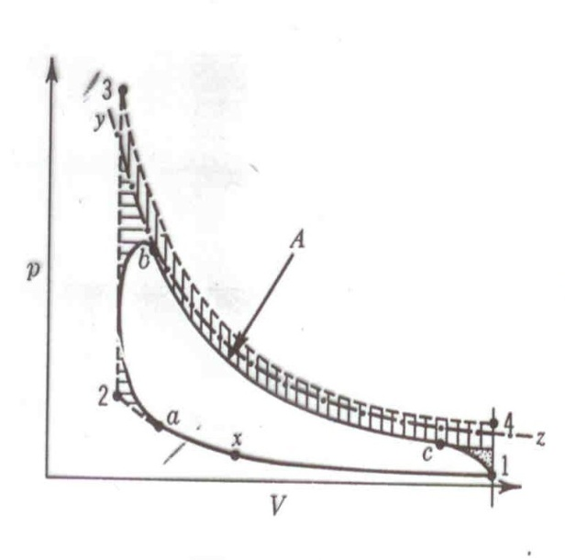
Comparing fuel-air cycle with actual cycle: A is actual cycle in the figure
yz is an isentrope through b. a is start of combustion & b is end. At c we have EVO. Point x is to both F-A and actual cycle. Main causes of difference between fuel-air and actual cycle are:
leakage,
incomplete mixing of fuel and air,
progressive burning,
time loss,
heat loss,
exhaust loss

Slide 26
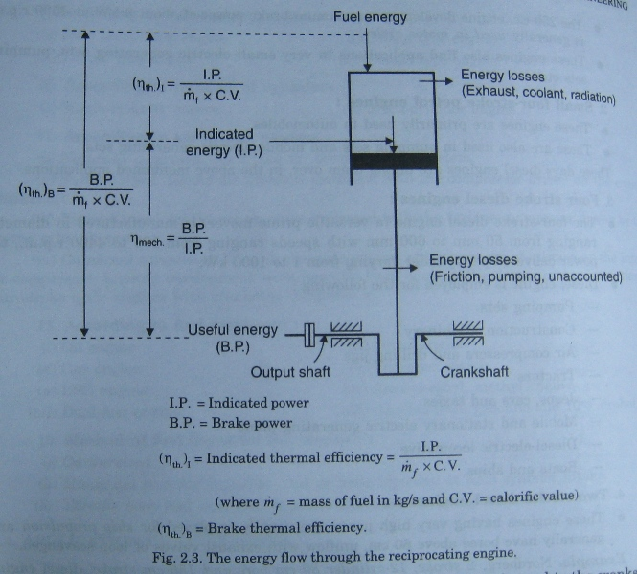
POWER DEVELOPED BY ICE

Slide 27
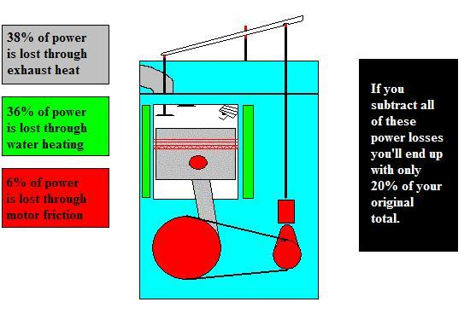
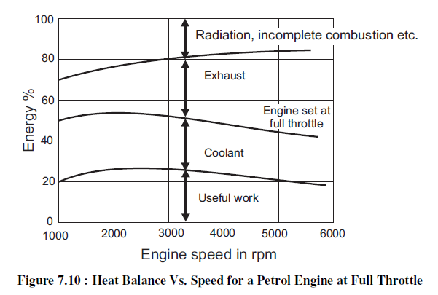
POWER LOSSES IN TYPICAL 4 STROKE ENGINE

Slide 28
Examples
A three liter spark-ignition V-6 engine operates on a 4-stroke cycle at 3000 rpm. The compression ratio is 9 and the engine is square. Determine:
The cylinder bore and the stroke length [8.6 cm]
The average piston speed [8.6 m/s]
The clearance volume of one cylinder [62.5 cm³]
A 2-stroke cycle ICE has a mep of 6 bar. The speed of the engine is 1000 rpm. If the diameter of piston and stroke are 110mm and 140mm respectively, find the indicated power developed.
Indicated power developed, IP = [n*mep[bar]*L[m]*A[m2]*N[rpm]*k*10]/6, kW
= [1*6*0.14*0.24*π*(0.11)²*1000*1*10]/6 = 13.3 kW
Note: k = 1 for 2-stroke & k = ½ for 4-stroke engine.

